Slide 1
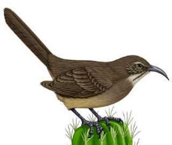

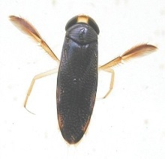
Species Interactions and Coexistence

Slide 2

























Organism/individual
Fitness
Behavior
Physiology
Etcetera
Population/ Metapopulation
Abundance
Growth/dynamics
Distribution
Community/Metacommunity
Coexistence/Assembly
Richness/diversity/Evenness
Scale and Beta-Diversity
Change through time (stability)
Food Webs and trophic structure (also mutualisms)
Biodiversity and ecosystem functioning (BEF)
Ecosystem fluxes and cycles
Time
Energy, Nutrients, water
Energy, Nutrients, water

Slide 3


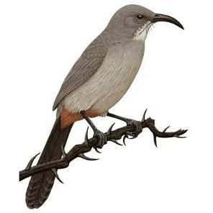

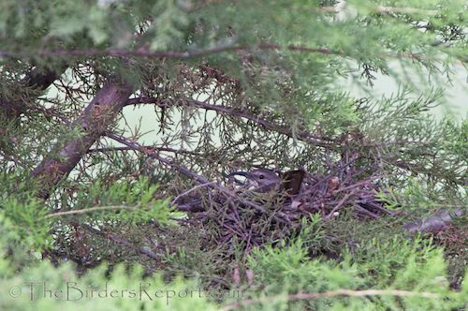


Lecture 7—Competition and Coexistence
A Brief History of the (Ecological) Niche Concept
Niche
Factor Y
Factor Z
Factor X
N-dimensional hyper-volume
Grinnell (1917)→ Elton (1927)→ Hutchinson (1957)

Slide 4
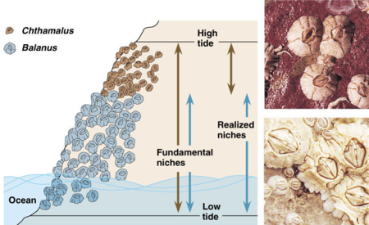
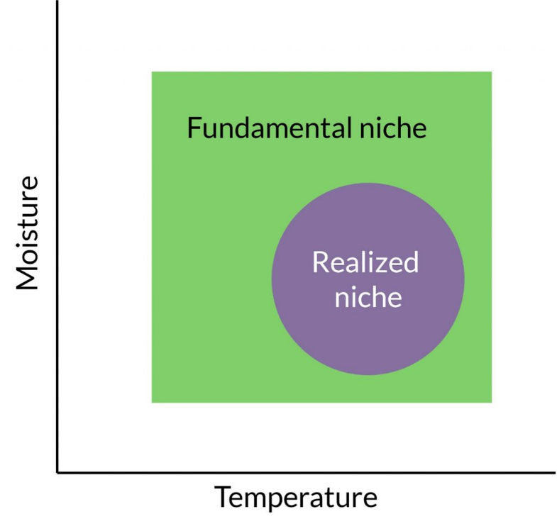
Fundamental vs. Realized Niche

Slide 5
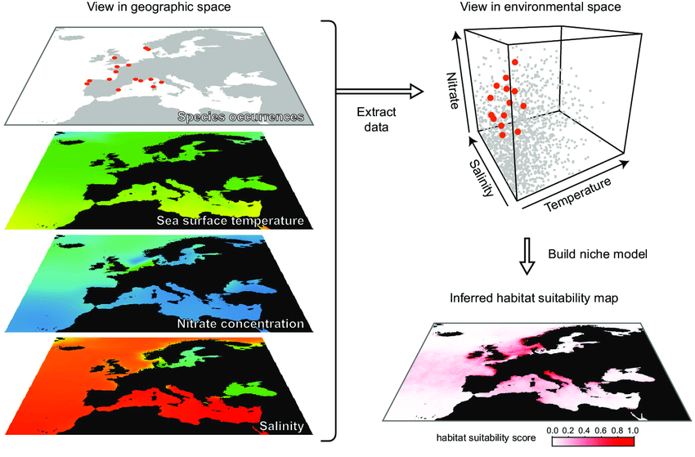
Statistical Associations
Niche modelling → Species Distribution Modelling

Slide 6
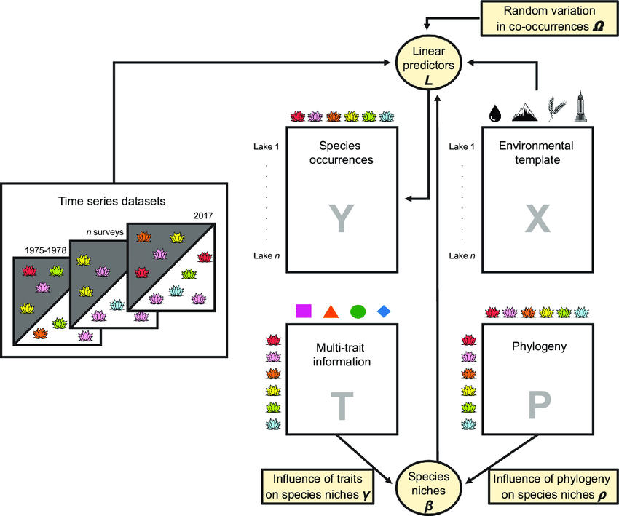
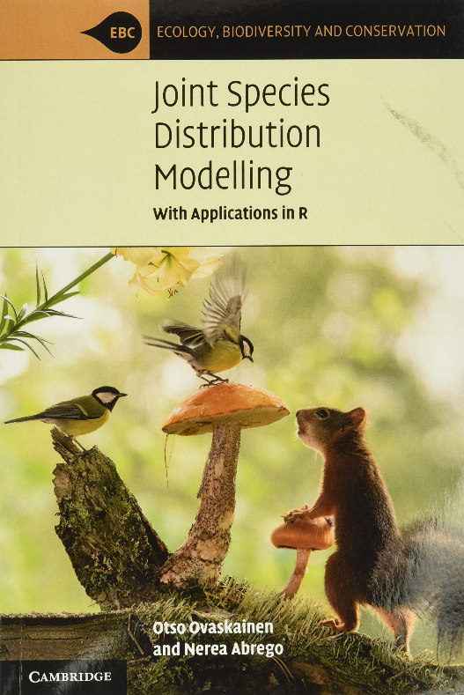
Statistical Associations
Joint Species Distribution Models (jSDMs)

Slide 7
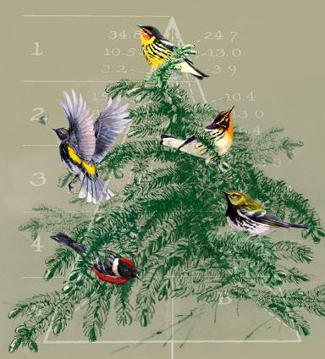
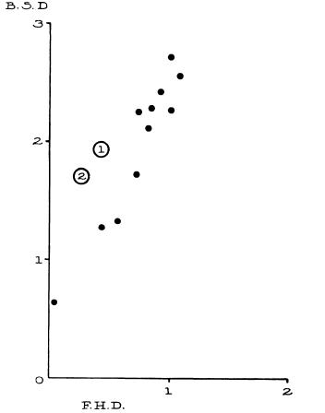
Ecological Niches as the Basis for Coexistence/Diversity
Bird Diversity
Foliage Height Diversity

Slide 8
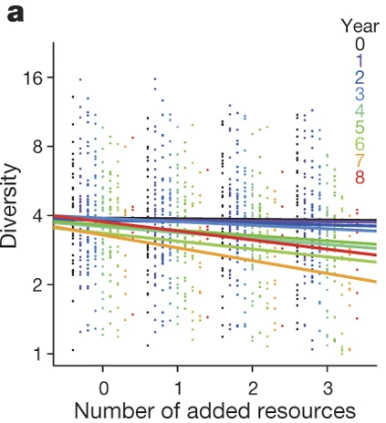
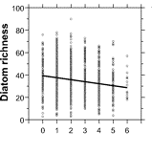
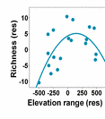
Niches at the forefront of biodiversity studies…..
Harpole et al. 2016, Nature
Resource Diversity
Passey 2008 PNAS
Allouche et al. 2012 PNAS

Slide 9
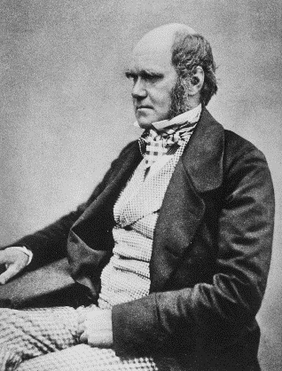
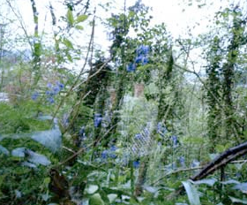
Entangled Bank
“As the species of the same genus usually have…much similarity in habits and constitution…the struggle will generally be more severe between them, if they come into competition with each other, than between the species of distinct genera.”

Slide 10
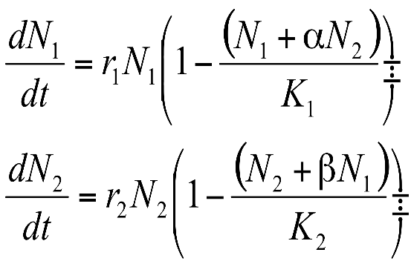

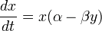
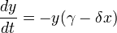
Lotka-Volterra: Interactions and Coexistence
Competition
Predator-Prey
Alfred Lotka
Vito Volterra

Slide 11
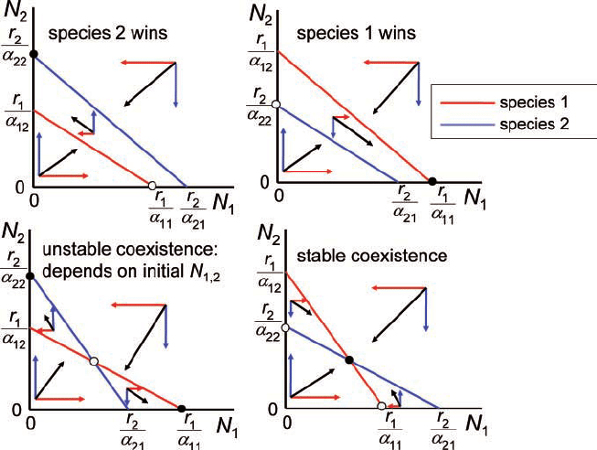
Lotka-Volterra Competition and Coexistence
Species with Highest Isocline wins
Coexist when Intraspecific effects > Interspecific effects
Priority effects when Intraspecific effects < Interspecific effects

Slide 12
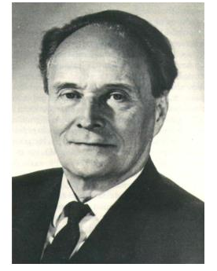
Gause 1934

Slide 13
Hardin G (1960) The competitive exclusion principle. Science 131:1292-1297
“It may be stated thus:
Complete competitors cannot coexist.”

Slide 14
What would these look like if species were identical?
??

Slide 15
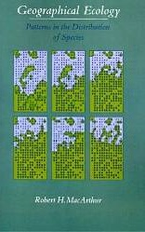


Using Consumer-Resource Models to Develop a Mechanistic theory of Coexistence

Slide 16
Back to Square 1:
N_{t}=Population in the current time step
N_{t+1}=Population in the next time step (t +1)
B=# Births
I=# of Immigrants
D=# Deaths
E=# Emigrants
Present→ B>D
Absent→ B<D
(in a closed population)

Slide 17
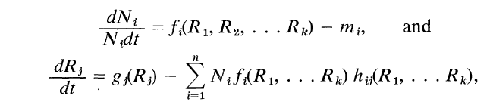
“Traditional models of competition, which form the basis of much of current ecological thought and theory, are non-mechanistic.”
Tilman 1982

Slide 18
The R* Principle
growth
Growth rate dN/Ndt
loss
R*
[R]

Slide 19
Two ‘parts’ of the Niche
growth
Requirement Niche
(Grinnell, Hutchinson—what a species needs)
Growth rate dN/Ndt
The ‘Impact’ Niche
(Elton—what a species does)
loss
R*
[R]

Slide 20
R* = level to which limiting resource is reduced at equilibrium
>
A
B
<
Limiting
Resource
Low R* species
= better competitor
Notes:
only resource comp, just say others eg
Resource Competition
Competition-Colonization
Spatial or Temporal Partitioning
Positive Interactions
Trophic Interactions

Slide 21
The R* Principle
A
Growth rate dN/Ndt
B
R*_{B}
R*_{A}
[R]
Two species together…the species with the lowest R* always wins
….when there is only one limiting resource, and the system is at equilibrium
…But, then how do species coexist??

Slide 22
A
Growth rate dN/Ndt
B
R*_{B}
R*_{A}
[R]
Requirement Niche>>Impact Niche
When only one resource…

Slide 23
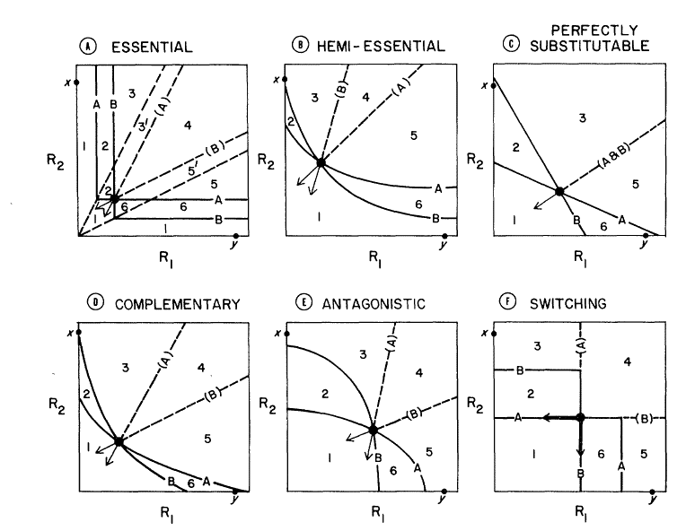
But what about when >1 resource?
(nitrogen, phosphorus, light, water, etc)
Resource 2
Tilman 1982
Resource 1
MacArthur 1972

Slide 24
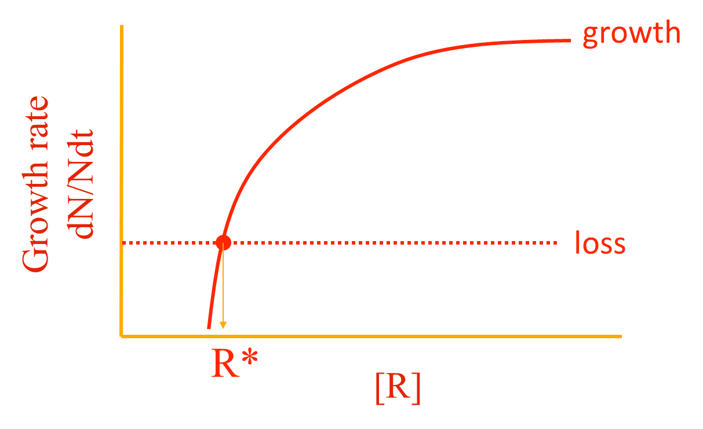
Building a Zero Net Growth Isocline (ZNGI): Essential Resources
(Requirement Niche in 2 Dimensions)
Inside requirement Niche
R2
[R₂]
A
Outside requirement Niche
[R₁]
R1

Slide 25
The Impact Vector
(the impact niche in 2 dimensions)
[R₂]
[R₁]

Slide 26
Two Species ZNGIs (Coexistence?)
A only
???
[R₂]
A
B only
B
[R₁]

Slide 27
Coexistence Requires Joint Trade-Offs
A only
A & B
[R₂]
A
B only
B
[R₁]

Slide 28
Unstable Coexistence and Priority Effects
A or B
(priority effects)
A only
[R₂]
A
B only
B
[R₁]
When impact vectors are reversed (species has greater impact on resource least limiting)

Slide 29
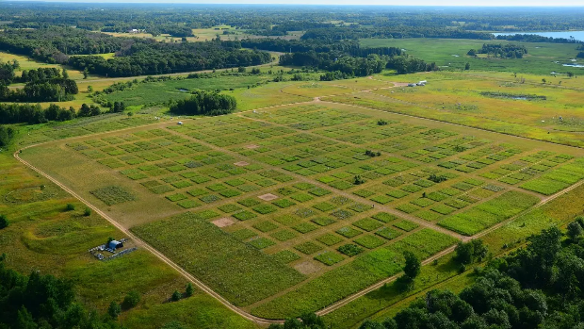
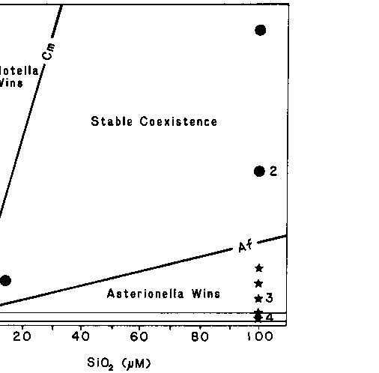
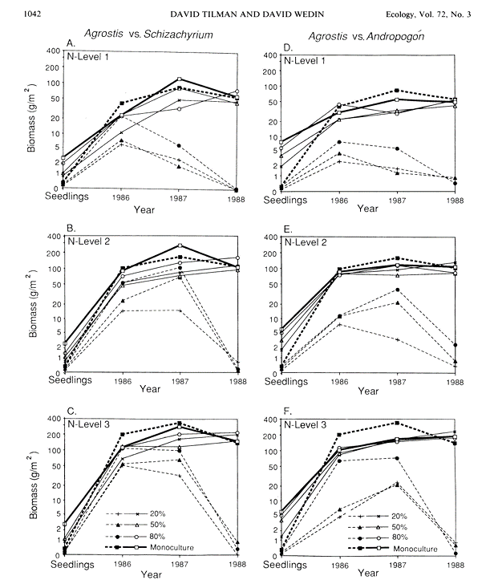
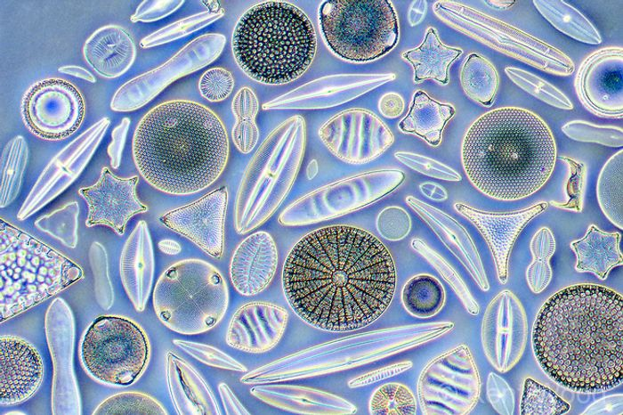
Empirical tests of R* theory

Slide 30
Miller et al. 2005 review of resource ratio theory:
1333 citations
8 predictions from theory
only 26 studies providing 42 adequate tests of theory (<2%!)
theoretical predictions supported 75% of time

Slide 31
Species can’t be too similar……
….but, they also can’t be too different
Chesson’s (2000) General Theory of Coexistence
Coexistence depends on the ratios of:
→Stabilizing Mechanisms (Can’t be too similar)
-Niche differences
→Equalizing Mechanisms (Can’t be too different) -Fitness differences
Modern Coexistence Theory (MCT)
Possible Coexistence
Possible Coexistence
Resource A
Resource B

Slide 32
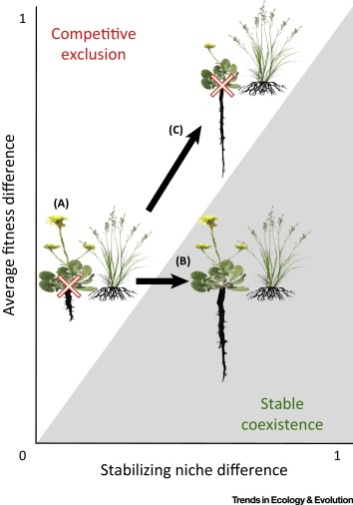
Modern Coexistence Theory Predictions

Slide 33
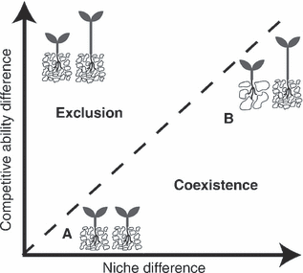
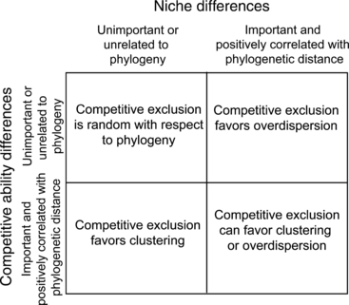
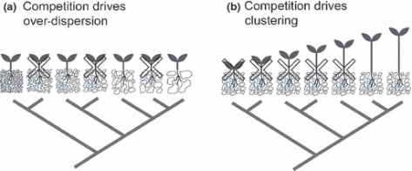
Phylogenetic/Functional Coexistence—from last time
Mayfield and Levine 2010, Ecology Letters

Slide 34
Narwani et al. 2013

Slide 35
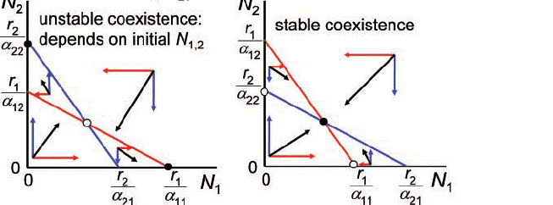
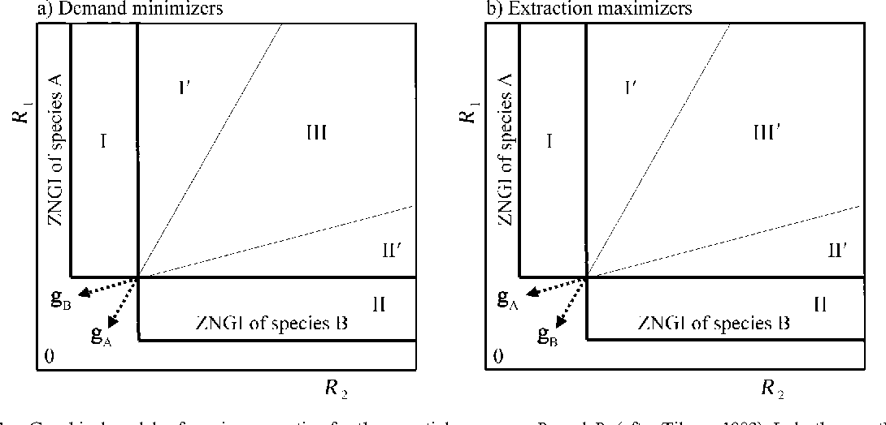
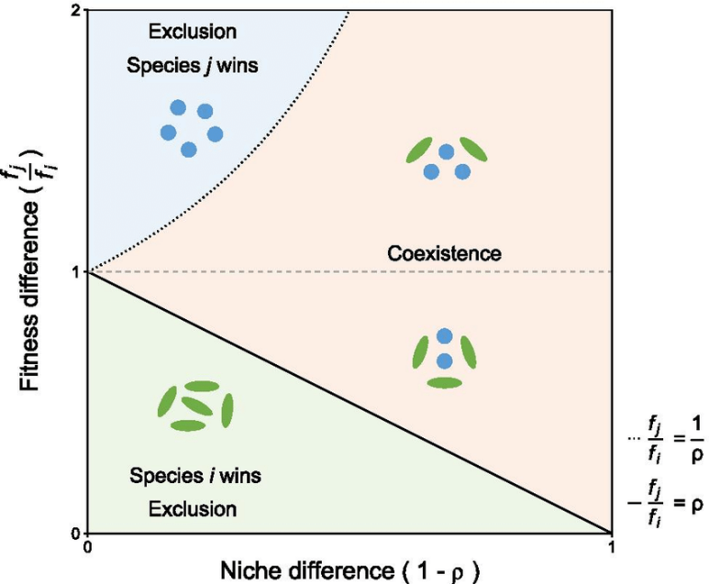
Lotka-Volerra
Consumer-Resource/Niche
Modern Coexistence Theory (MCT)
Coexistence:
Intraspecific effects > Interspecific Effects
Priority effects:
Intraspecific effects < Interspecific Effects
Neutral:
Intraspecific effects = Interspecific Effects

Slide 36
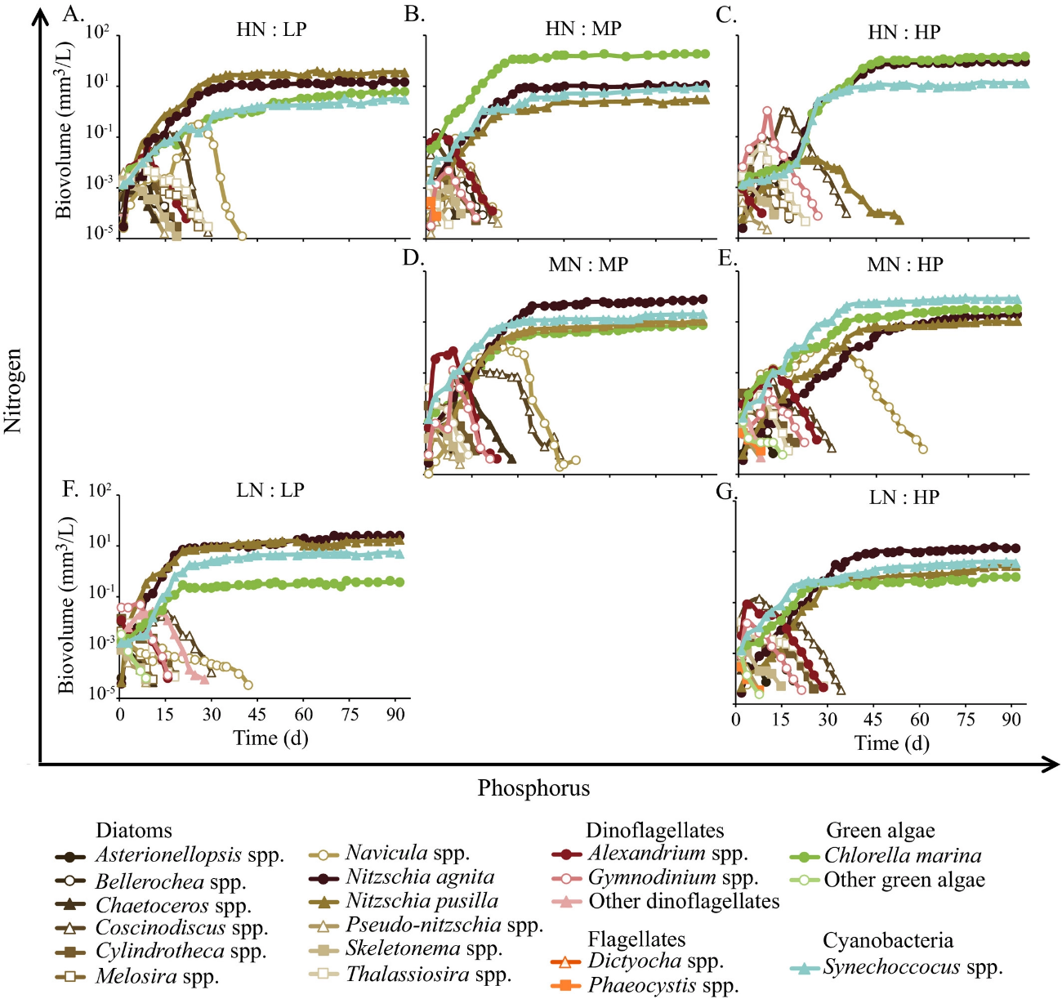
So, how do many species coexist on few resources?
Burson et al. 2018 Ecology

Slide 37
Questions?

Slide 38
Break: 15 minutes

Slide 39
Lecture 8—Coexistence in Time, Space, Food webs, etc.
Trade-Offs
Coexistence:
Intraspecific effects > Interspecific Effects
Priority effects:
Intraspecific effects < Interspecific Effects
Neutral:
Intraspecific effects = Interspecific Effects

Slide 40
Other factors that influence coexistence:
Time—Intrinsic and extrinsic
Space—Heterogeneity, dispersal
Simple view:
-1 resource=1 species
-2 resources=2 species
-N resources=N species
But often:
-N Resources << N species
Interactions between them
Frequency Dependence, colonization competition
Space, time and predation
--Janzen-Connell effects
Other limiting factors:
Disturbance/Stress
Apparent Competition via Shared Predators
Keystone Predation

Slide 41
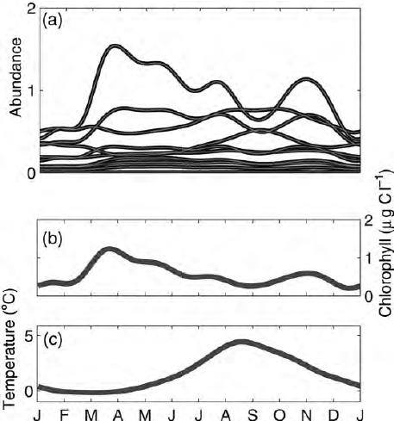
Adding temporal variation to allow coexistence
Problem→too many phytoplankton for Number of resources
Hutchinson GE (1961) The paradox of the plankton. American Naturalist
Solution→Seasonality/Movement in water colume keeps things from Outcompeting each other
Early ‘Neutral’ Perspective
There is a possibility that these organisms are so nearly equal in their ability to compete that they do not eliminate each other
Riley 1963

Slide 42
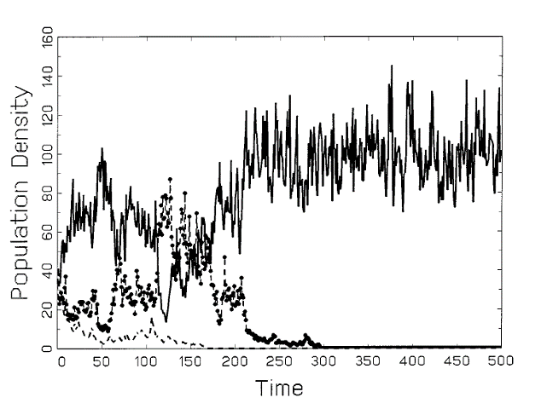
But Seasonality and Fluctuations not enough: Need Trade-Offs!
Chesson and Huntly 1997, American Naturalist

Slide 43
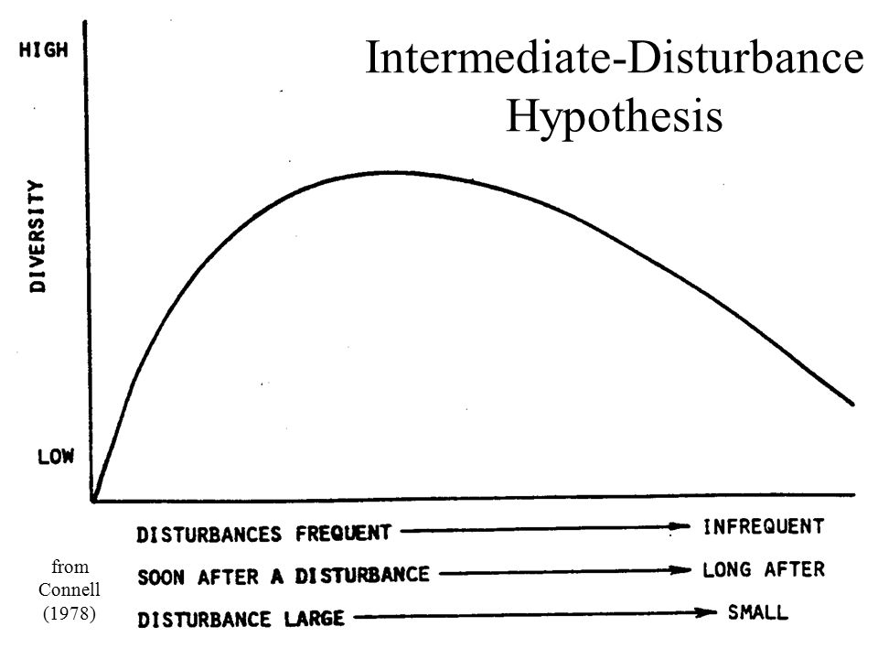
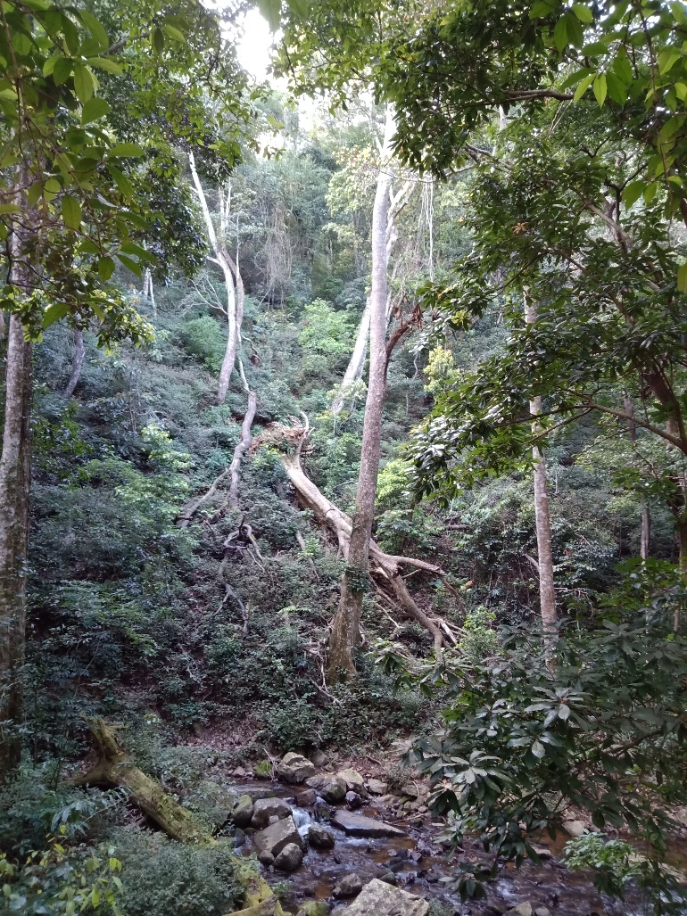
Connell (1978): Intermediate Disturbance Hypothesis
Connell 1978; Intermediate Disturbance Hypothesis

Slide 44
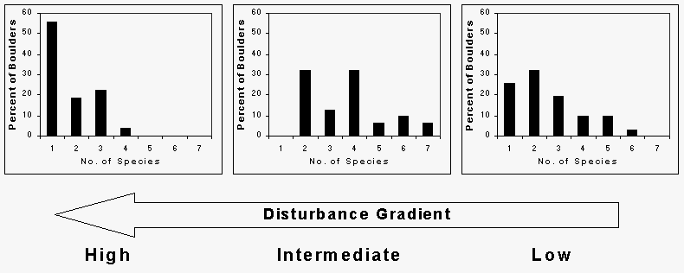
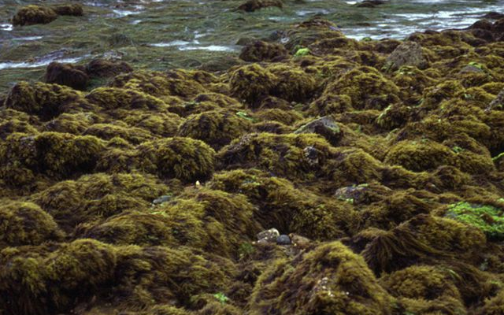
Tests of Intermediate Disturbance Hypothesis
Sousa 1979 Ecology

Slide 45
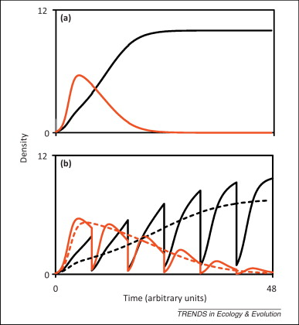
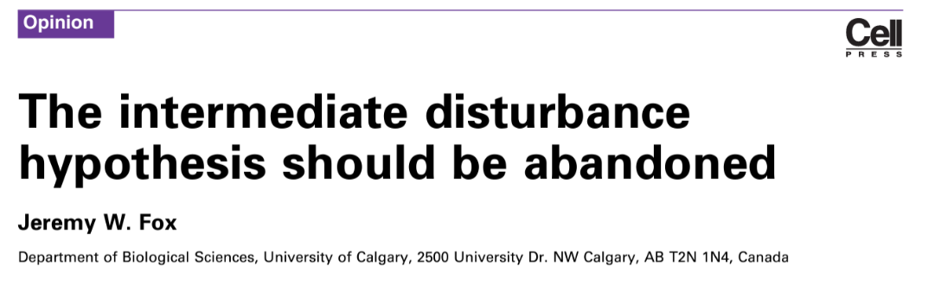
Disturbance not enough: Need Trade-Offs!

Slide 46
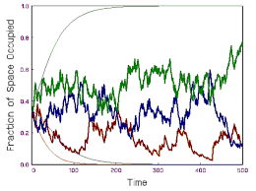
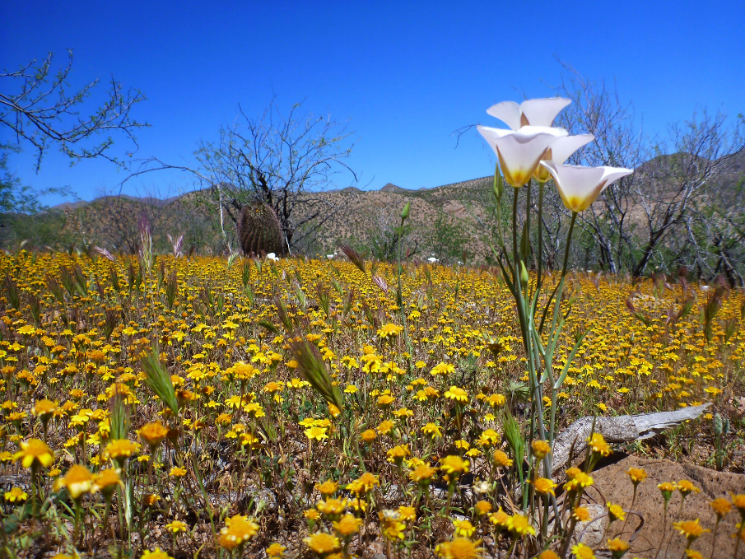

The ‘Storage’ Effect: Trade-offs in time
‘Store’ as Long-lived Seeds
Trade-offs in growth vs. seed longevity
‘Store’ as Long-lived adults
Trade-offs in reproduction vs. longevity
Chesson 2000

Slide 47
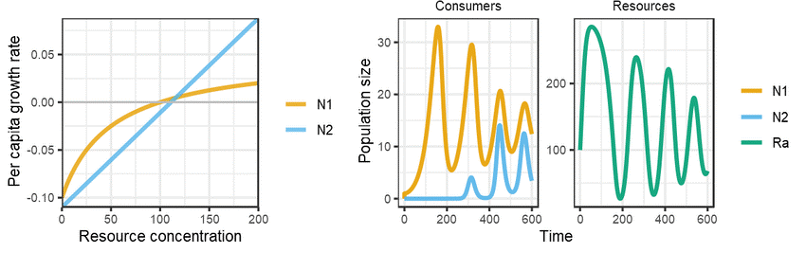
Intrinsic Temporal Variation and Coexistence
Predator-Prey Oscillations and Trade-Offs
e.g., Armstrong and McGehee 1976
Theoretical Population Biology

Slide 48
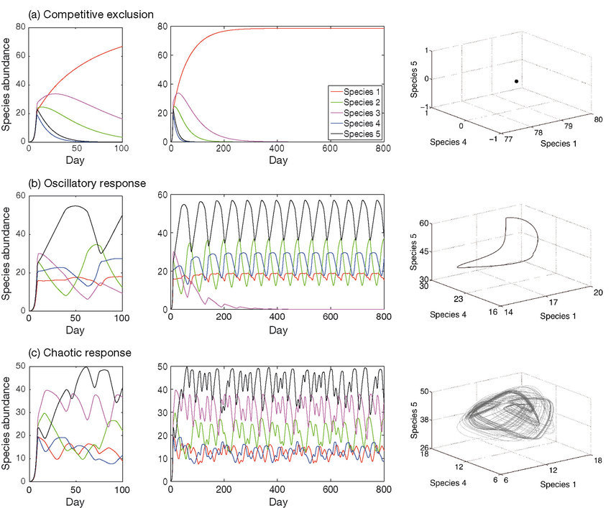
Many Species on Few Resources (Oscillations and Chaos)
Huisman and Weissing 1999 Nature
Still Requires Trade-Offs!

Slide 49

Adding Space:
Spatial processes influence Coexistence → metacommunity
Habitat heterogeneity → Species Sorting

Slide 50
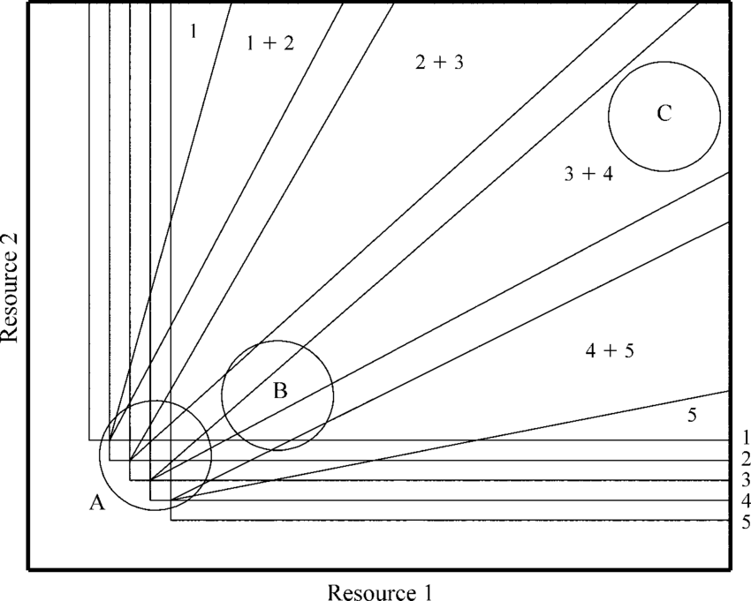
Many Species, 2 resources (with spatial heterogeneity)
Resource Supply
Tilman and Pacala 1993

Slide 51
Even classic coexistence stories had a spatial component
Gause 1934

Slide 52
Even classic coexistence stories had a spatial component
Gause 1934

Slide 53


Space and Time: Competition-Colonization Trade-Off

Slide 54

Space and Time: Competition-Colonization Trade-Off

Slide 55

Intrinsic Spatial-Temporal Coexistence:
Dispersal and Frequency Dependence
Hart et al. 2017, Nature Ecology and Evolution

Slide 56


Janzen-Connell Effects
Frequency-Dependence Mediated by Enemies: Space, Time and Enemies
Janzen “Herbivores and the Number of Tree Species in Tropical Forests." Am. Nat. 104.940 (1970)
Connell, J.H. "On the role of natural enemies in preventing competitive exclusion in some marine animals and in rain forest trees." In: Dyn. of Pop. Wageningen:Pudoc, 1971

Slide 57

The Janzen-Connell Mechanism is Frequent
?? Does it lead to diversity?
Comita et al. 2014, J. Ecology

Slide 58



Other limiting factors: Enemies, Stress

Slide 59


Adding other limiting factors
Modules:
Resources
Predators
Stress

Slide 60
Fundamental Principle of Coexistence: Linked trade-offs
Resource Competition
Apparent Competition
Coexist
Resource A
Predator A
Coexist
Resource B
Predator B
Keystone Predation
Disturbance/variation
Predator
Disturbance/ Stress
Coexist
Coexist
Resource
Resource
Chase and Leibold 2003

Slide 61
Questions??
10 minute break

Slide 62




Breakout Groups and Discussion
What about facilitation?
What about Mutualism?

Slide 63

A graphical model?
?
?
Or a different approach
Potential guiding questions for Discussion:
What do we need to consider?
How is it similar to competition or predator
How does it differ from competition or predation?
How does it change our understanding of communities?

